Slide 1

Lecture
on
“Advanced Computer Architecture –TCS 704”
by
Akansha Gupta
DEPARTMENT OF COMPUTER SCIENCE AND ENGINEERING
GRAPHIC ERA DEEMED TO BE UNIVERSITY – 248002

Slide 2
Trends in Computer Architecture
Trends in Technology
– Performance: bandwidth vs. latency
– Transistor and wire scaling
• Trends in Power
• Trends in Cost
• Trends in Reliability

Slide 3
Dependability
The Infrastructure providers offer Service Level Agreement (SLA) or Service Level Objectives (SLO) to guarantee that their networking or power services would be dependable.
Systems alternate between 2 states of service with aspect to an SLA:
Service accomplishment, where the service is delivered as specified in SLA
Service interruption, where the delivered service is different from the SLA
• Failure = transition from state 1 to state 2
• Restoration = transition from state 2 to state 1

Slide 4
The two main measures of Dependability are Module Reliability and Module Availability.
Module reliability is a measure of continuous service accomplishment (or time to failure) from a reference initial instant.
Mean Time To Failure (MTTF) measures Reliability
Failures In Time (FIT) = 1/MTTF, the rate of failures
Traditionally reported as failures per billion hours of operation
Mean Time To Repair (MTTR) measures Service Interruption
– Mean Time between Failures (MTBF) = MTTF+MTTR

Slide 5
Module availability measures service as alternate between the 2 states of accomplishment and interruption (number between 0 and 1, e.g. 0.9)
Module availability = MTTF / ( MTTF + MTTR)

Slide 6
Performance
The Execution time or Response time is defined as the time between the start and completion of an event.
The total amount of work done in a given time is defined as the Throughput.
The Administrator of a data center may be interested in increasing the Throughput.
The computer user may be interested in reducing the Response time.

Slide 7
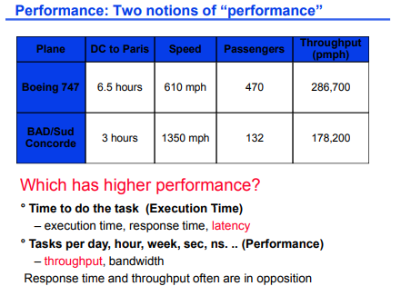

Slide 8
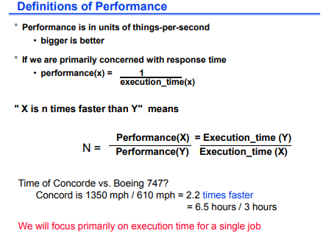

Slide 9
Amdahl’s Law
Amdahl’s law is used to find the performance gain that can be obtained by improving some portion or a functional unit of a computer.
Amdahl’s law defines the speedup that can be gained by using a particular feature.

Slide 10
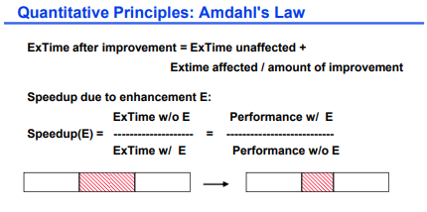

Slide 11
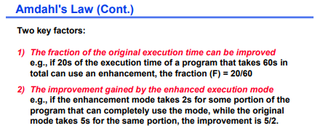

Slide 12
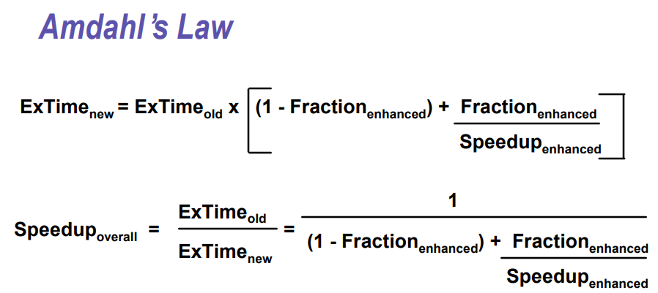

Slide 13
https://youtu.be/Md-4GXe-qtU
thanks

